Slide 1
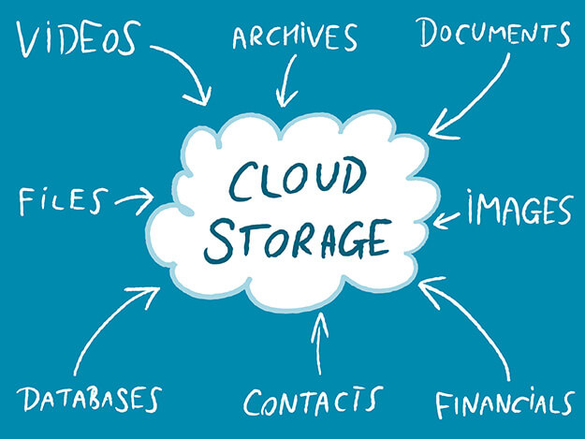
Azure Cloud Storage
The principles behind Azure Cloud Storage usage within the .Net C# environment.

Slide 2
What is Azure Cloud Storage
Azure Storage is Microsoft's cloud storage solution for modern data storage scenarios. Azure Storage offers a massively scalable object store for data objects, a file system service for the cloud, a messaging store for reliable messaging, and a NoSQL store.

Slide 3
Azure Storage is:
Durable and highly available
Redundancy ensures that your data is safe in the event of transient hardware failures. You can also opt to replicate data across datacenters or geographical regions for additional protection from local catastrophe or natural disaster. Data replicated in this way remains highly available in the event of an unexpected outage.
Secure
All data written to Azure Storage is encrypted by the service. Azure Storage provides you with fine-grained control over who has access to your data.
Scalable
Azure Storage is designed to be massively scalable to meet the data storage and performance needs of today's applications.
Managed
Microsoft Azure handles hardware maintenance, updates, and critical issues for you.
Accessible.
Data in Azure Storage is accessible from anywhere in the world over HTTP or HTTPS. Microsoft provides client libraries for Azure Storage in a variety of languages, including .NET, Java, Node.js, Python, PHP, Ruby, Go, and others, as well as a mature REST API. Azure Storage supports scripting in Azure PowerShell or Azure CLI. And the Azure portal and Azure Storage Explorer offer easy visual solutions for working with your data.

Slide 4
Azure Storage services
Azure Storage includes these data services:
Azure Blobs
A massively scalable object store for text and binary data.
Azure Files
Managed file shares for cloud or on-premises deployments.
Azure Queues
A messaging store for reliable messaging between application components.
Azure Tables
A NoSQL store for schemaless storage of structured data.

Slide 5
Blob storage
Azure Blob storage is Microsoft's object storage solution for the cloud. Blob storage is optimized for storing massive amounts of unstructured data, such as text or binary data.
Blob storage is ideal for:
Serving images or documents directly to a browser.
Storing files for distributed access.
Streaming video and audio.
Storing data for backup and restore, disaster recovery, and archiving.
Storing data for analysis by an on-premises or Azure-hosted service.
Objects in Blob storage can be accessed from anywhere in the world via HTTP or HTTPS. Users or client applications can access blobs via URLs, the Azure Storage REST API, Azure PowerShell, Azure CLI, or an Azure Storage client library. The storage client libraries are available for multiple languages, including .NET, Java, Node.js, Python, PHP, and Ruby.

Slide 6
Azure Files
Azure Files enables you to set up highly available network file shares that can be accessed by using the standard Server Message Block (SMB) protocol. That means that multiple VMs can share the same files with both read and write access. You can also read the files using the REST interface or the storage client libraries.
One thing that distinguishes Azure Files from files on a corporate file share is that you can access the files from anywhere in the world using a URL that points to the file and includes a shared access signature (SAS) token. You can generate SAS tokens; they allow specific access to a private asset for a specific amount of time.

Slide 7
Common Scenarios
Many on-premises applications use file shares. This feature makes it easier to migrate those applications that share data to Azure. If you mount the file share to the same drive letter that the on-premises application uses, the part of your application that accesses the file share should work with minimal, if any, changes.
Configuration files can be stored on a file share and accessed from multiple VMs. Tools and utilities used by multiple developers in a group can be stored on a file share, ensuring that everybody can find them, and that they use the same version.
Diagnostic logs, metrics, and crash dumps are just three examples of data that can be written to a file share and processed or analyzed later.
At this time, Active Directory-based authentication and access control lists (ACLs) are not supported, but they will be at some time in the future. The storage account credentials are used to provide authentication for access to the file share. This means anybody with the share mounted will have full read/write access to the share.

Slide 8
Queue storage
The Azure Queue service is used to store and retrieve messages. Queue messages can be up to 64 KB in size, and a queue can contain millions of messages. Queues are generally used to store lists of messages to be processed asynchronously.
For example, say you want your customers to be able to upload pictures, and you want to create thumbnails for each picture. You could have your customer wait for you to create the thumbnails while uploading the pictures. An alternative would be to use a queue. When the customer finishes their upload, write a message to the queue. Then have an Azure Function retrieve the message from the queue and create the thumbnails. Each of the parts of this processing can be scaled separately, giving you more control when tuning it for your usage.

Slide 9
Table storage
Azure Table storage is a service that stores structured NoSQL data in the cloud, providing a key/attribute store with a schemaless design. Because Table storage is schemaless, it's easy to adapt your data as the needs of your application evolve. Access to Table storage data is fast and cost-effective for many types of applications, and is typically lower in cost than traditional SQL for similar volumes of data.
You can use Table storage to store flexible datasets like user data for web applications, address books, device information, or other types of metadata your service requires. You can store any number of entities in a table, and a storage account may contain any number of tables, up to the capacity limit of the storage account.

Slide 10
What is Table storage?
Azure Table storage stores large amounts of structured data. The service is a NoSQL datastore which accepts authenticated calls from inside and outside the Azure cloud. Azure tables are ideal for storing structured, non-relational data. Common uses of Table storage include:
Storing TBs of structured data capable of serving web scale applications
Storing datasets that don't require complex joins, foreign keys, or stored procedures and can be denormalized for fast access
Quickly querying data using a clustered index
Accessing data using the OData protocol and LINQ queries with WCF Data Service .NET Libraries
You can use Table storage to store and query huge sets of structured, non-relational data, and your tables will scale as demand increases.

Slide 11
Table Storage Concepts
Account
Table
Entity
Name = Bob
Email = b@g.com
Customers
Name = Jane
Email = j@g.com
@Solution
Photo ID = 1
Date = 2010.9
Photos
Photo ID = 2
Date = 2015.8
Notes:
The Table service provides structured storage in the form of tables.
The Table service supports a REST API that is compliant with the ADO.NET Data Services REST API.
Developers may also use the .NET Client Library for ADO.NET Data Services to access the Table service.
Notes
http://msdn.microsoft.com/en-us/library/dd573356.aspx

Slide 12
Table Properties
URL format:
Azure Table Storage accounts use this format:
http://<storage account>.table.core.windows.net/<table>
Azure Cosmos DB Table API accounts use this format:
http://<storage account>.table.cosmosdb.azure.com/<table>
Accounts: All access to Azure Storage is done through a storage account.
Table: A table is a collection of entities. Tables don't enforce a schema on entities, which means a single table can contain entities that have different sets of properties.
Entity: An entity is a set of properties, similar to a database row. An entity in Azure Storage can be up to 1MB in size. An entity in Azure Cosmos DB can be up to 2MB in size.
Properties: A property is a name-value pair. Each entity can include up to 252 properties to store data. Each entity also has three system properties that specify a partition key, a row key, and a timestamp. Entities with the same partition key can be queried more quickly, and inserted/updated in atomic operations. An entity's row key is its unique identifier within a partition.

Slide 13
Entity Properties
Entity can have up to 255 properties
Up to 1MB per entity
Mandatory Properties for every entity
PartitionKey & RowKey (only indexed properties)
Uniquely identifies an entity
Defines the sort order
Timestamp
Optimistic Concurrency
Exposed as an HTTP Etag
No fixed schema for other properties
Each property is stored as a <name, typed value> pair
No schema stored for a table
Properties can be the standard .NET types
String, binary, bool, DateTime, GUID, int, int64, and double
Notes:
Tables store data as entities.
An entity is a collection of named properties and their values, similar to a row- not an RDBMS though
Tables are partitioned to support load balancing across storage nodes.
Each table has as its first property a partition key that specifies the partition an entity belongs to.
The second property is a row key that identifies an entity within a given partition.
The combination of the partition key and the row key forms a primary key that identifies each entity uniquely within the table.
The Table service does not enforce any schema.
A developer may choose to implement and enforce a schema on the client side
Notes
http://msdn.microsoft.com/en-us/library/dd573356.aspx
http://msdn.microsoft.com/en-us/library/dd179338.aspx

Slide 14
Purpose of the PartitionKey
Entity Locality
Entities in the same partition will be stored together
Efficient querying and cache locality
Endeavour to include partition key in all queries
Entity Group Transactions
Atomic multiple Insert/Update/Delete in same partition in a single transaction
Table Scalability
Target throughput – 500 tps/partition, several thousand tps/account
Windows Azure monitors the usage patterns of partitions
Automatically load balance partitions
Each partition can be served by a different storage node
Scale to meet the traffic needs of your table
Notes:
Tables are partitioned to support load balancing across storage nodes.
A table's entities are organized by partition.
A partition is a consecutive range of entities possessing the same partition key value.
The partition key is a unique identifier for the partition within a given table, specified by the PartitionKey property.
The partition key forms the first part of an entity's unique identifier within the table.
The partition key may be a string value up to 1 KB in size.
You must include the PartitionKey property in every insert, update, and delete operation.
Notes
http://msdn.microsoft.com/en-us/library/dd573356.aspx
http://blogs.msdn.com/b/windowsazurestorage/archive/2010/05/07/understanding-the-scalability-availability-durability-and-billing-of-windows-azure-storage.aspx
http://blogs.msdn.com/b/windowsazurestorage/archive/2010/05/10/windows-azure-storage-abstractions-and-their-scalability-targets.aspx

Slide 15
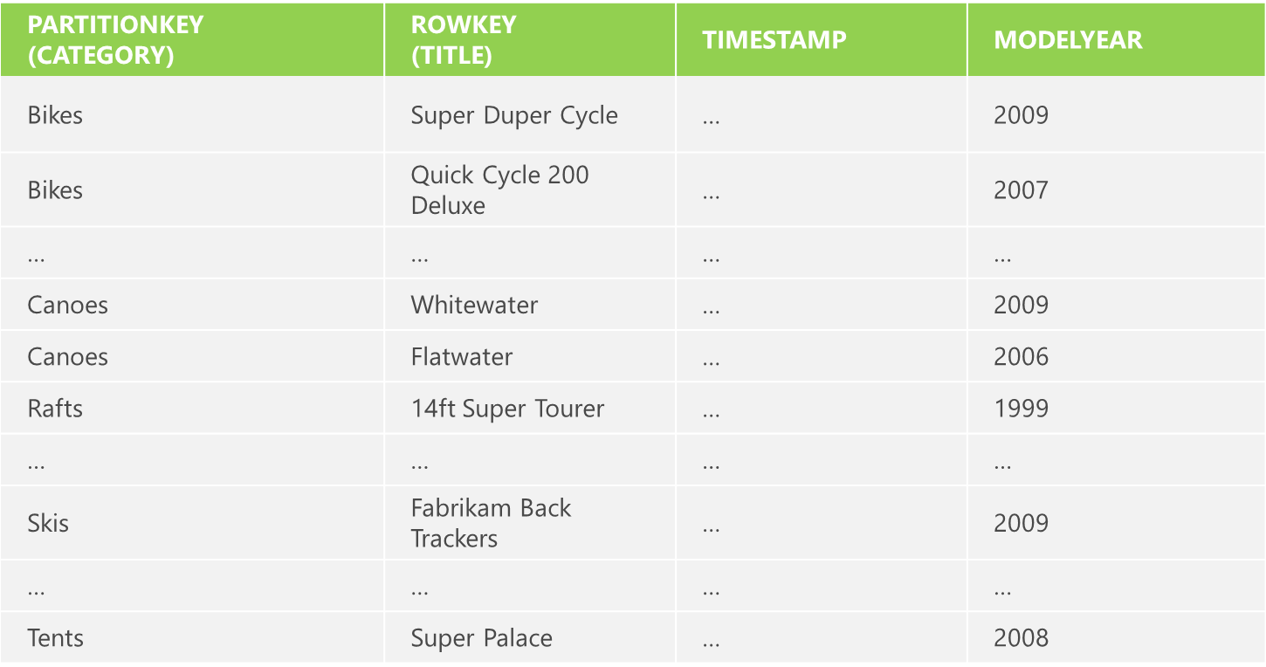
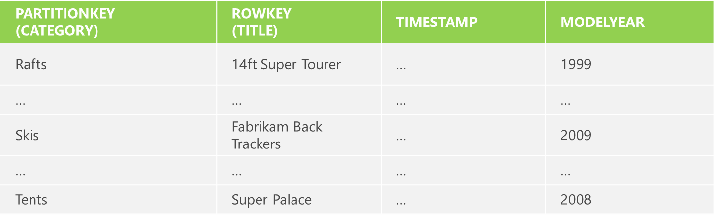
Partitions and Partition Ranges
Server A
Table = Products
[MinKey - Canoes)
Server B
Table = Products
[Canoes - MaxKey)
Notes:
DON’T use unique PartionKey values for your entities – each entity will then belong to its own partition
Range partitions group entities that have sequentially, unique PartitionKey values to improve the performance of range queries.
Without range partitions, a range query will need to cross partition boundaries or server boundaries, which can decrease the performance of the query.
Notes

Slide 16
Getting Started with Azure SDK and Storage Emulator
In this section we will create a simple console application that will test to ensure that our “Emulated” Azure Cloud Storage is working on our development machines.

Slide 17
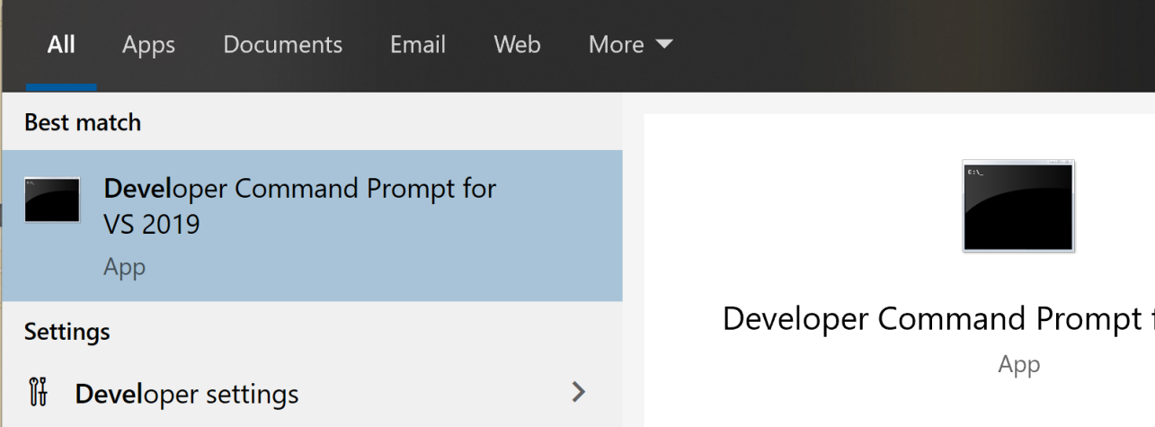
The Developer Command Prompt
This Developer Command Prompt is used to execute command line actions that will work with Visual Studio 2019 Community IDE.
In this section we will utilize it to “emulate” an Azure Cloud Storage server. This is helpful, because during development we usually will not have access to a real Azure Cloud Storage server and this allows us to simulate one for our development environment.
Find and run this program on your development laptop. If this does not exist, please let me know so we can work to install the correct packages for it’s use.

Slide 18
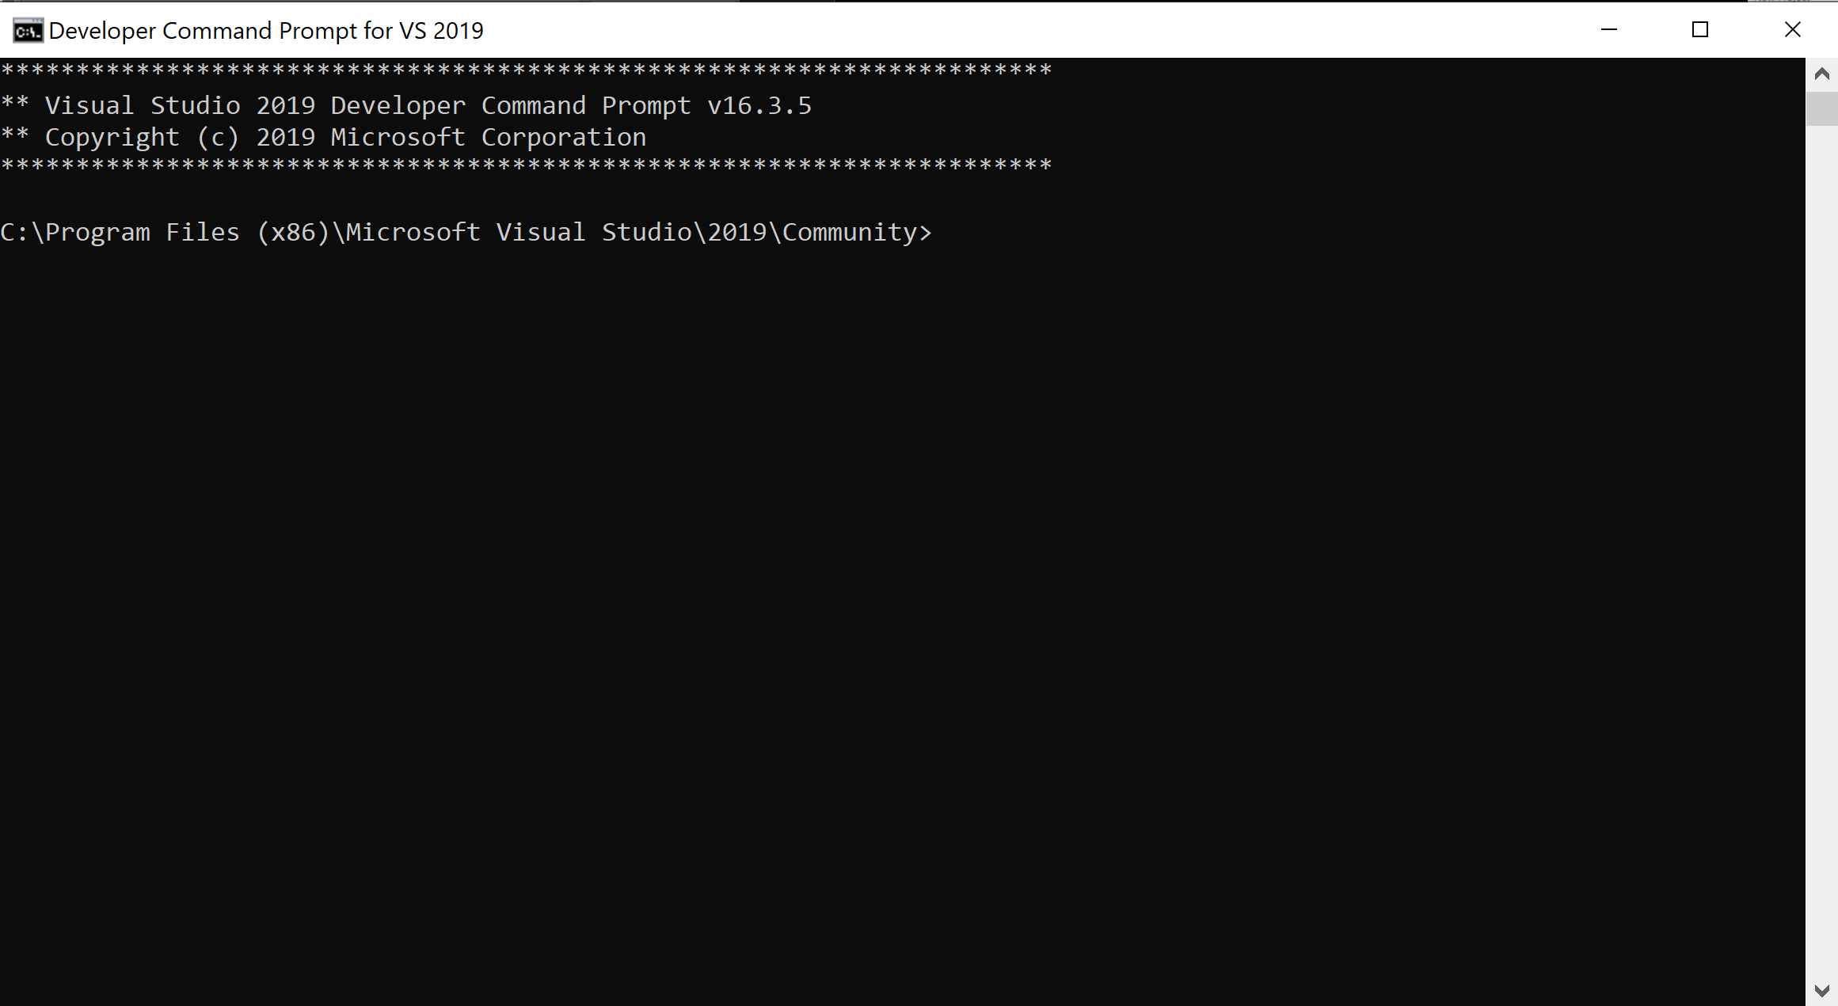
The Developer Command Prompt
When the Developer Command Prompt is ran, it will initially be in the Visual Studio IDE folder, however, we need to move to the Emulator folder and then start the emulator. To do this, we first have to change the directory to the correct folder and then run the start command for the emulator.

Slide 19
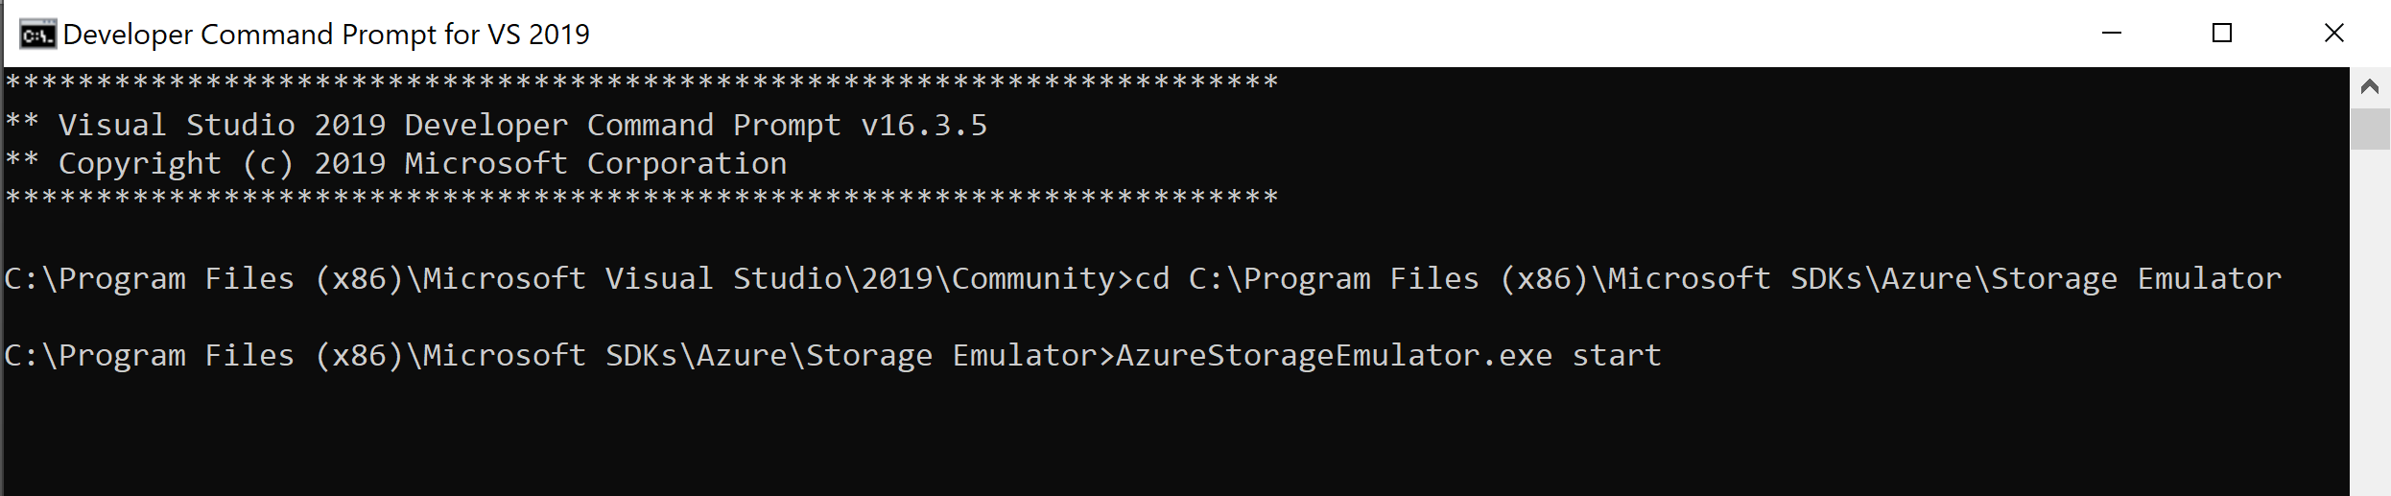
The Developer Command Prompt
The command to change directories in the Developer Command Prompt is “cd {directory}”. This means that we need execute the command:
cd C:\Program Files (x86)\Microsoft SDKs\Azure\Storage Emulator
NOTE: the “/” is replaced with the “¥” character
After we have changed the directory, we then execute the emulator startup command:
AzureStorageEmulator.exe start
Notes:
cd

Slide 20
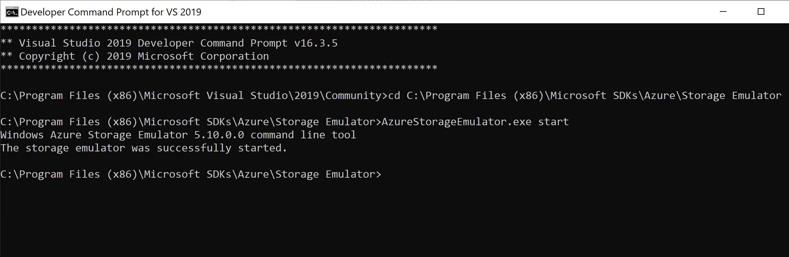
The Developer Command Prompt
It will tell you that the “emulator was successfully started”.
If this does not happen and your emulator fails to start, please contact me as soon as possible so we can resolve this issue.
Now that we have our Azure Storage Emulator started, let’s create a new project to test that the storage is working properly.

Slide 21
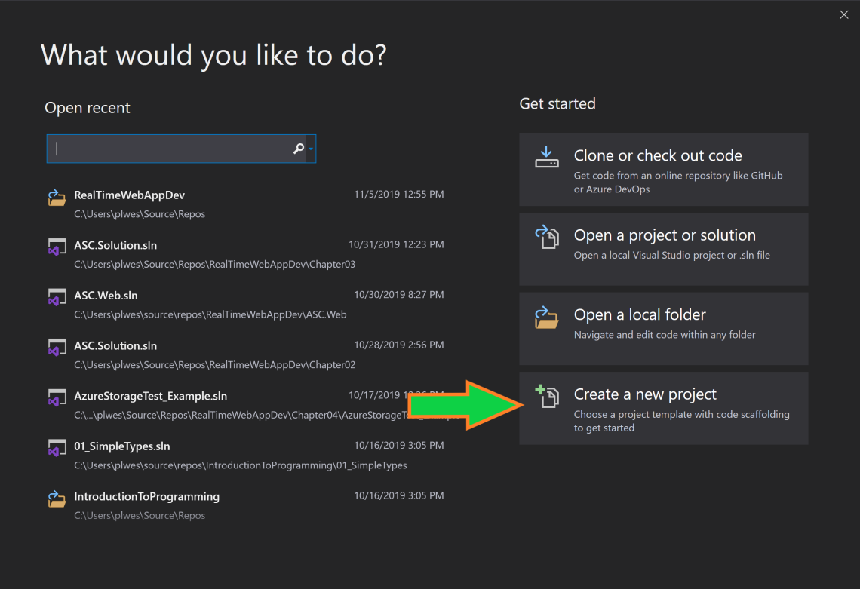
Test Application Creation
Begin by running Visual Studio 2019.
Once the IDE loads, you will get the menu above.
Select “Create a new project”

Slide 22
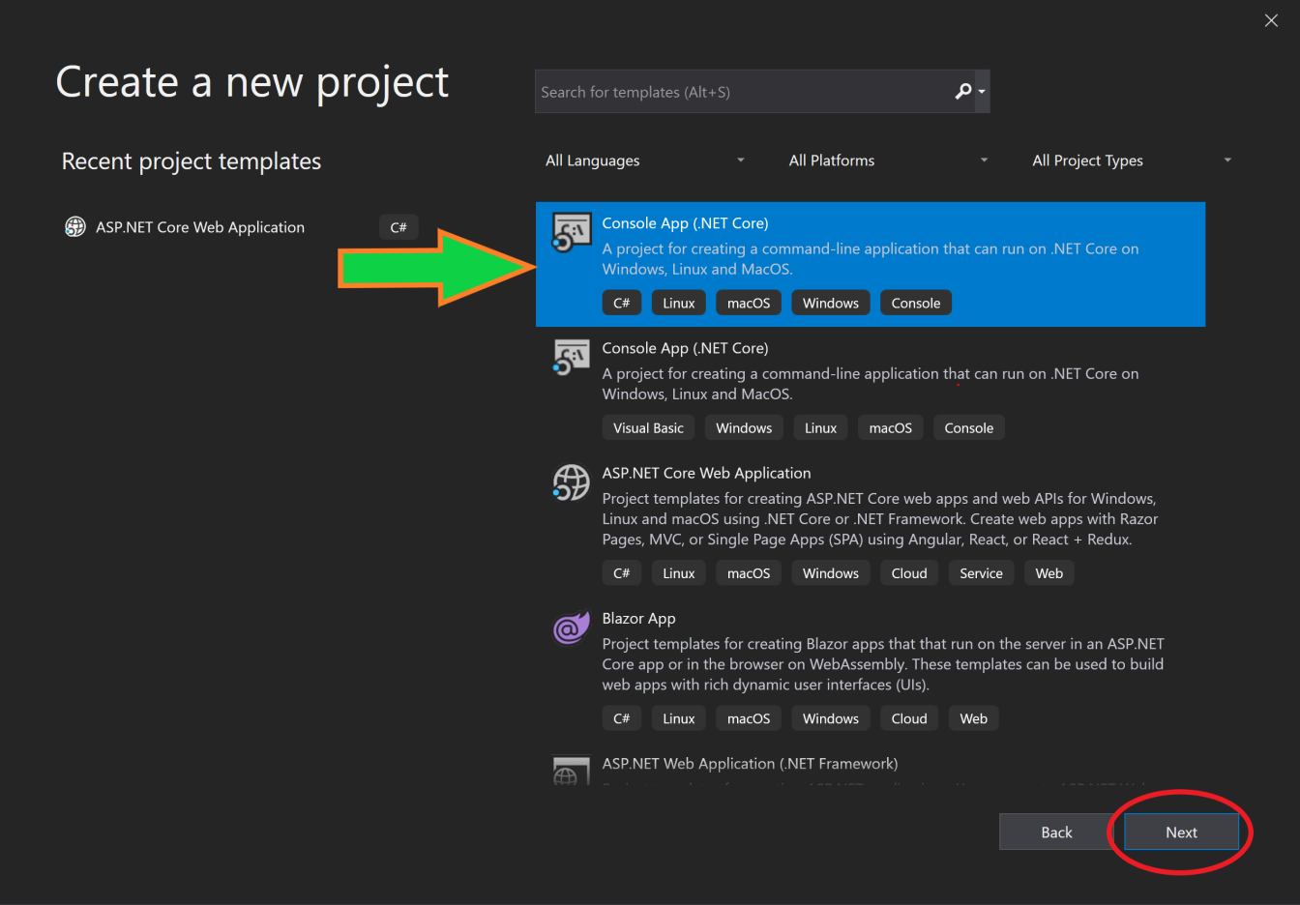
Test Application Creation
Select the “Console App .NET Core”
Click “Next”

Slide 23
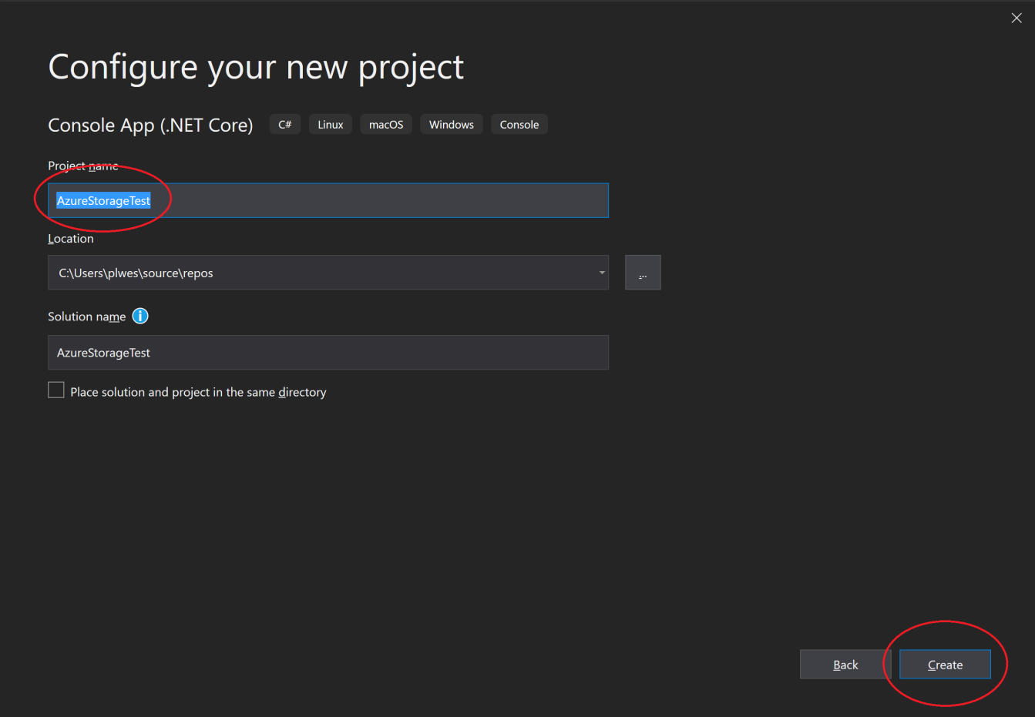
Test Application Creation
Name the project “AzureStorageTest”
Click “Create”

Slide 24
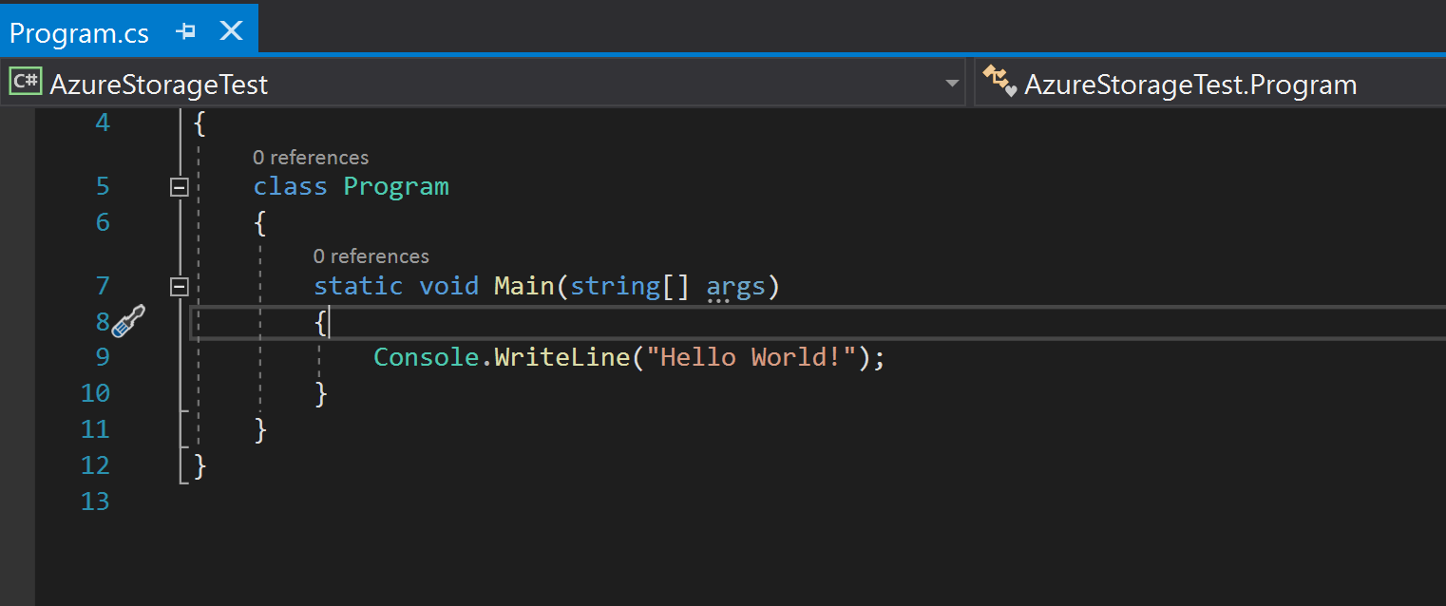
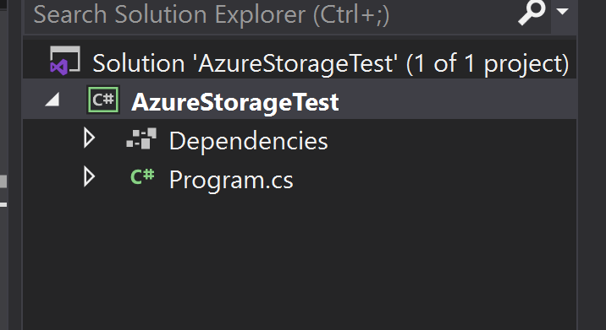
Test Application Creation
This will create a basic Console Application with nothing more than a Main Method that prints “Hello World” to the console. However, we will modify this to create a “test” application for the Emulated Azure Cloud Storage.

Slide 25
NuGet Package Management
NuGet Package Manager is a tool that allows us to install “packages” that were created by other programmers from around the world.
A package is a set of code files that together that provide some functionality for your application.
In our Azure Cloud Storage Test application, we will be installing the Azure Cloud Storage NuGet Package.

Slide 26
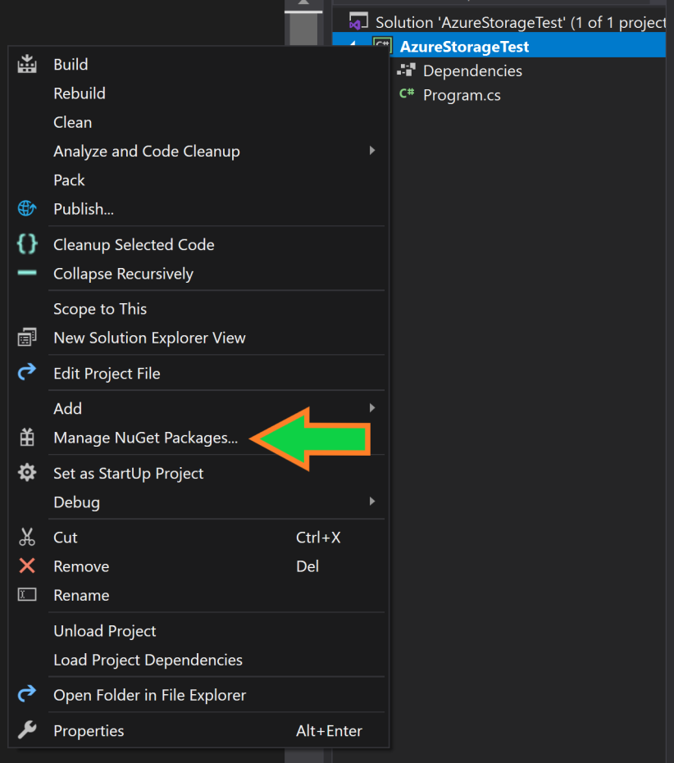
Installing the Azure Storage NuGet Package
First, we have to open the NuGet Package Manager.
“Right-Click” on the “AzureStorageTest” solution.
Select the “Manage NuGet Packages…” menu item.

Slide 27
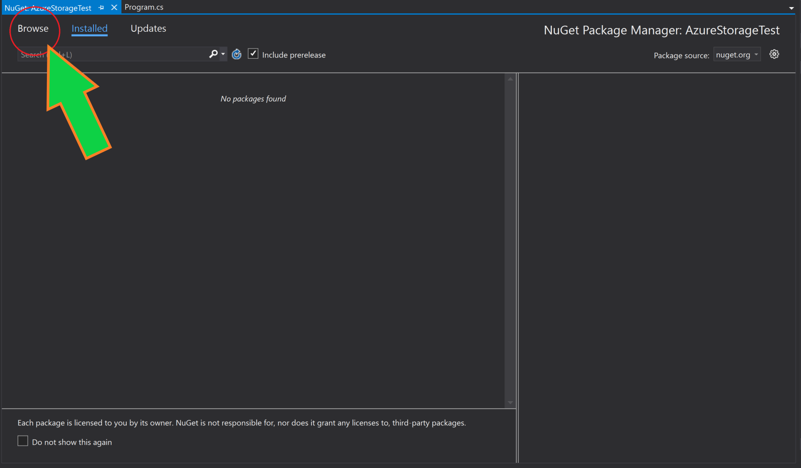
Installing the Azure Storage NuGet Package
This brings up the NuGet Package Manager window. However, it defaults to the NuGet Packages that you have installed currently. We will have to change that by selecting the “Browse” tab at the top of the manager window.

Slide 28
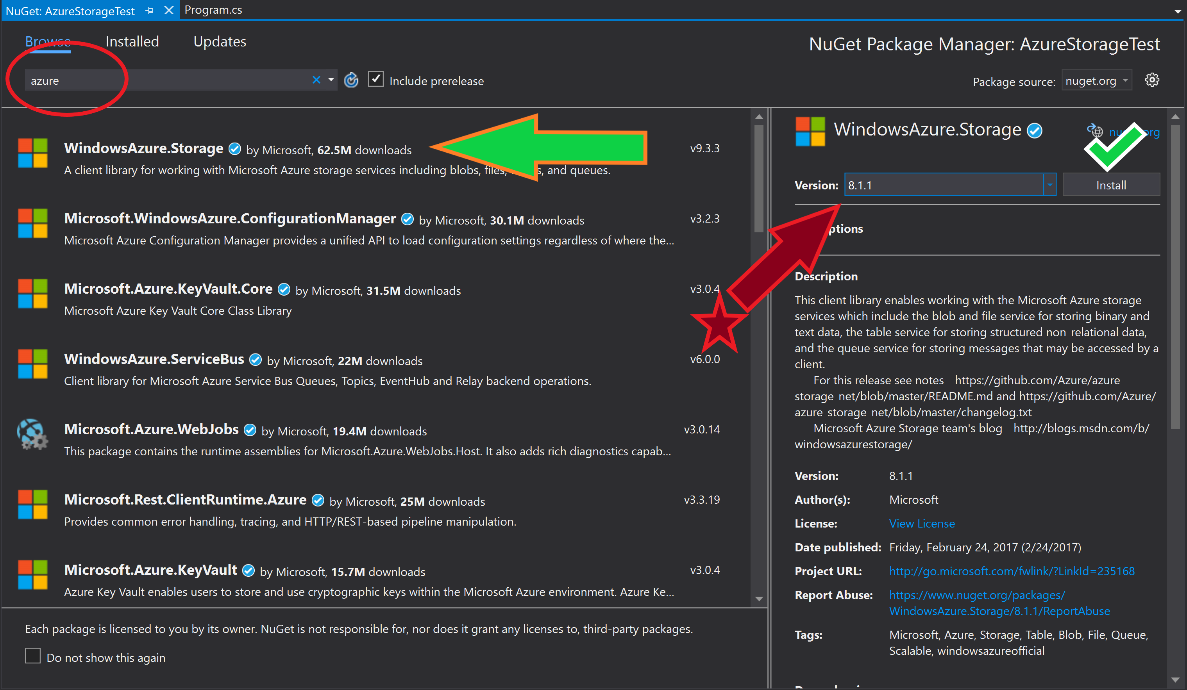
Installing the Azure Storage NuGet Package
Once in the “Browse” menu, search for “Azure”
Select the “WindowsAzure.Storage” menu item.
Change the version to “8.1.1”
Select “Install”

Slide 29
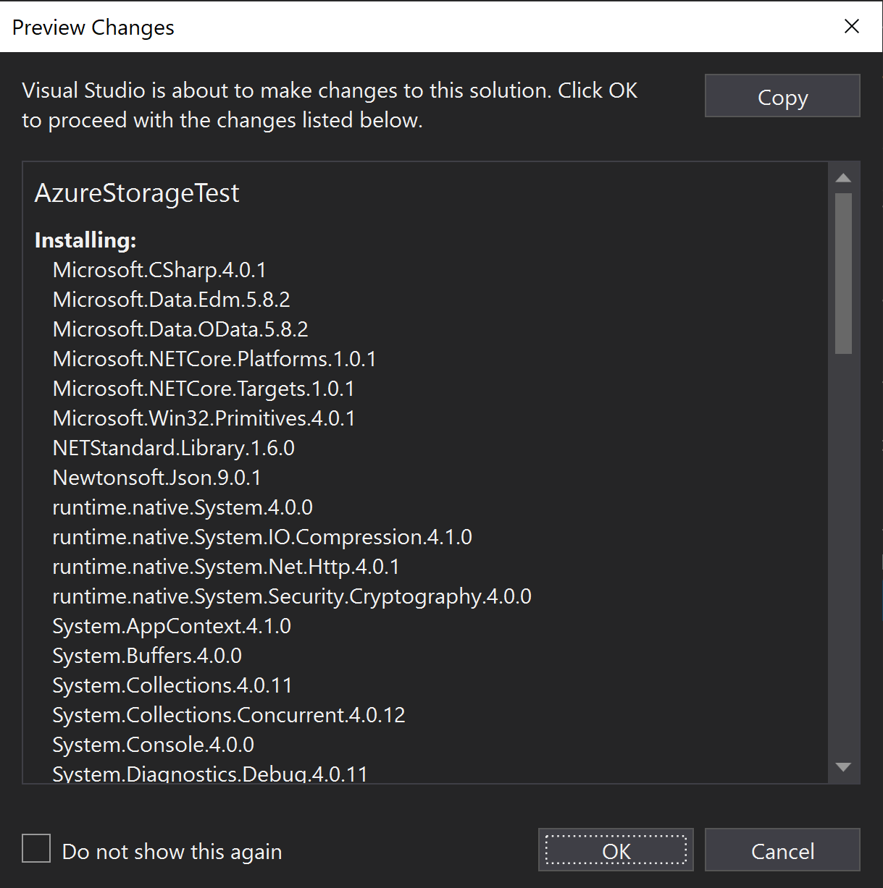
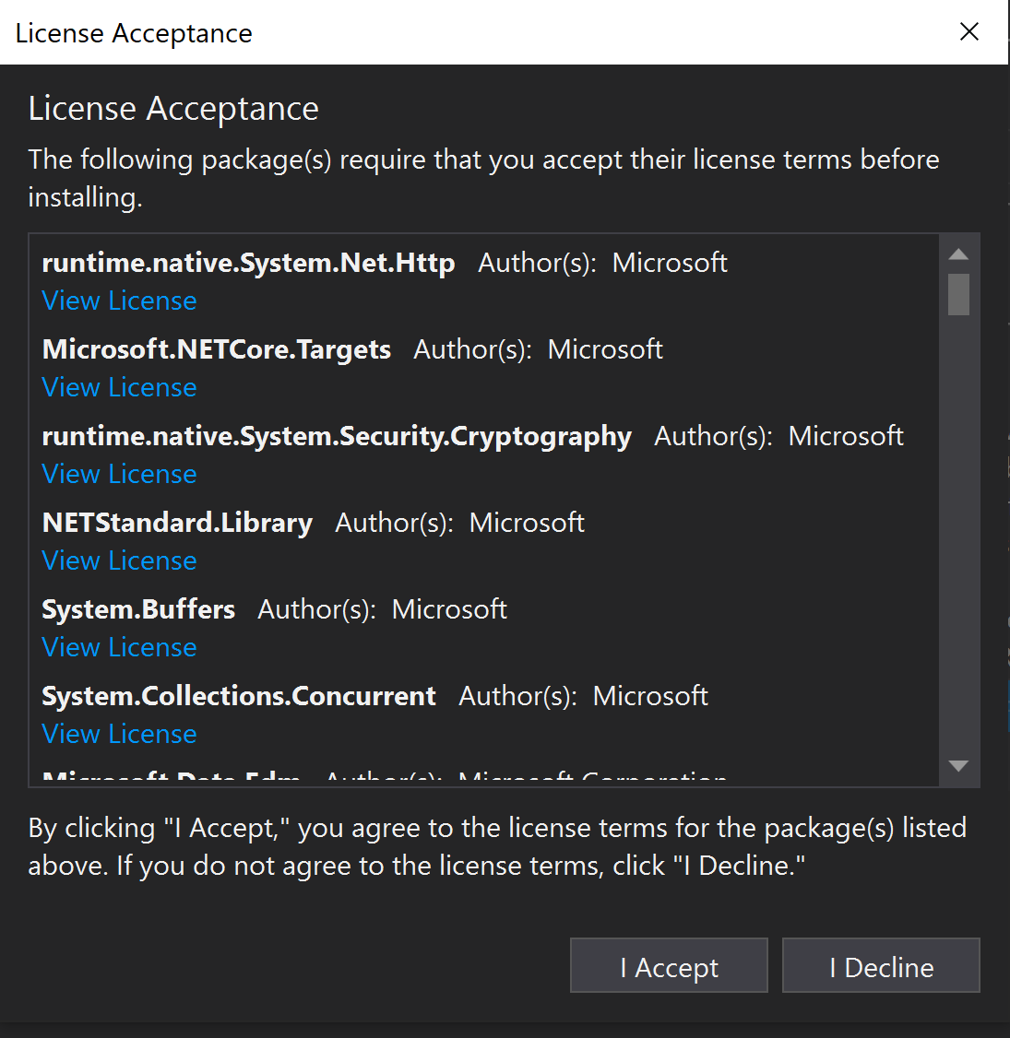
Installing the Azure Storage NuGet Package
After Selecting “Install” you will have 2 more menus that require you make decisions.
Select the “Ok” and “I Accept” to begin the installation.

Slide 30
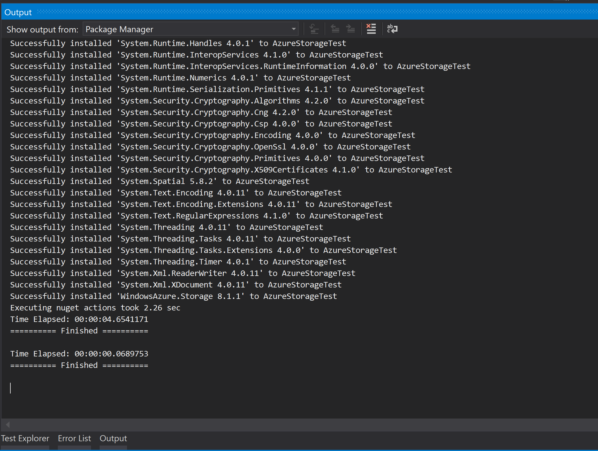
Installing the Azure Storage NuGet Package
When finished installing, the “Output” window should have the following message. It should not have failed installation, and if it did, please contact me for assistance.

Slide 31
What did we just do?!?!?!
NuGet packages install code files that become part of the solution, but we do not have access to change them. They are managed by a third-party, but we agree to use them as they are intended to be used for the purpose of developing our own software.
Every NuGet package will have some form of online documentation if you want to find out more details on any given NuGet Package.
Now that we have our NuGet Package, let’s create the files we will need to test the Azure Cloud Storage.

Slide 32
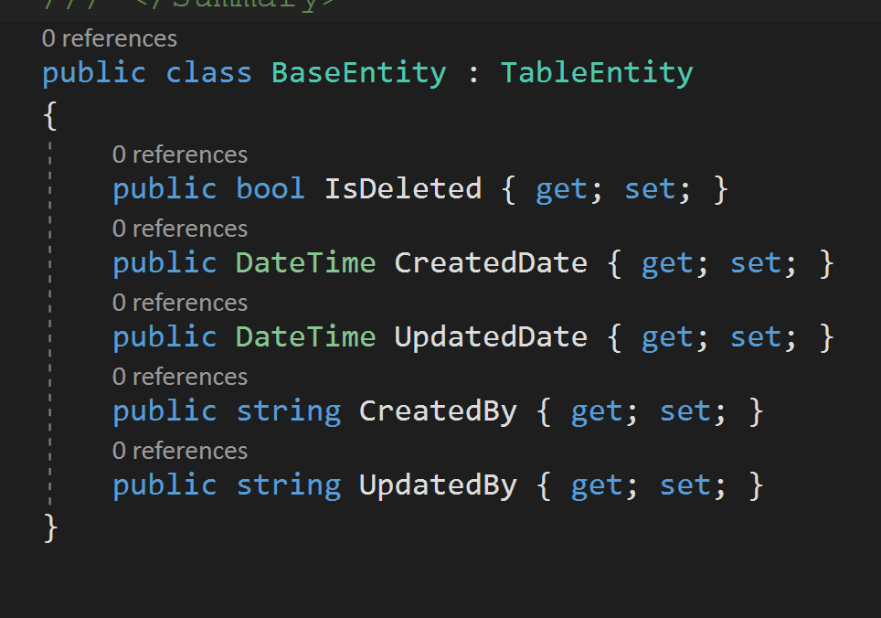
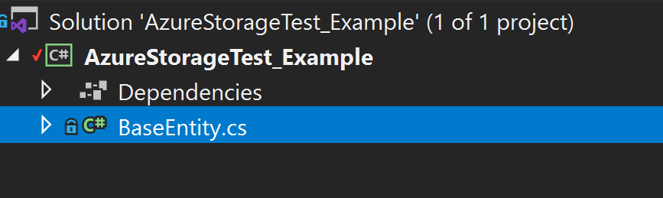
BaseEntity Creation
The “Base Entity” is a class that inherits the TableEntity class from the NuGet Package that we installed previously. The TableEntity class was created by Microsoft for us to use when we want to create “entities” that we want stored in the Azure Cloud Storage as table information.
Our “BaseEntity” class will have properties that EVERYTHING we want to store in the database will have as properties. This is the information that is important to every entity that will be stored in the database

Slide 33
BaseEntity Creation
IsDeleted{ get; set;}
This property allows us to manage whether an entity has been deleted from the database table. This is important so we can keep consistency between the information in our application, and the information in the database.
CreatedDate { get; set; }
In database and entity management, it is a nice thing to know when something was created.
UpdatedDate { get; set; }
In database and entity management, it is a nice thing to know when something is changed or updated.

Slide 34
BaseEntity Creation
CreateBy{ get; set;} and UpdatedBy{ get; set; }
To keep track of the person that is creating or updating entities for the database.
This can be important if we want to allow users to find items in the database that they created. It is also important for legal and audit information to know who has been changing the database information.

Slide 35
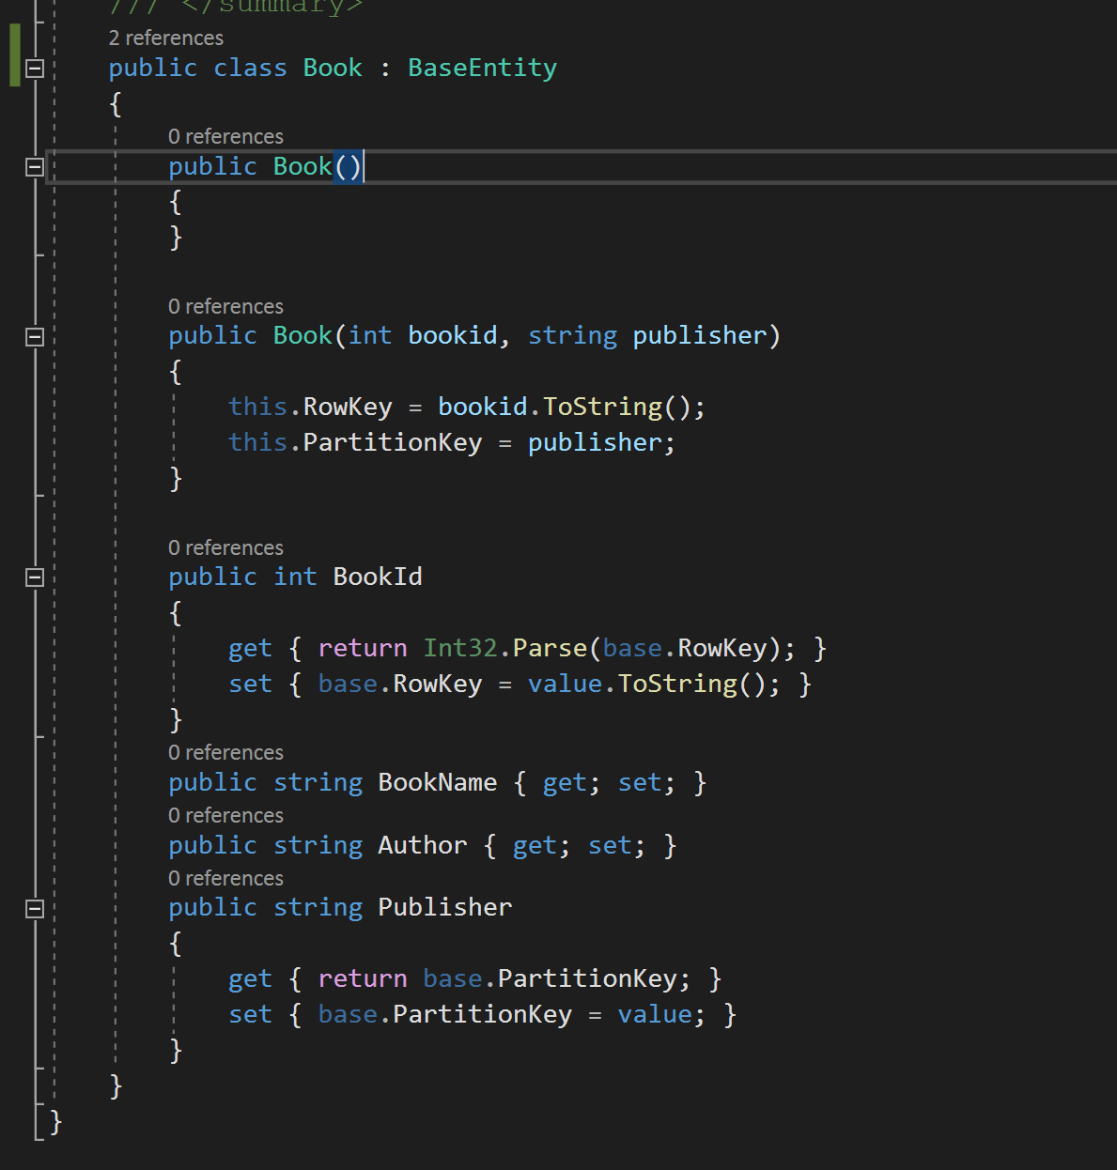
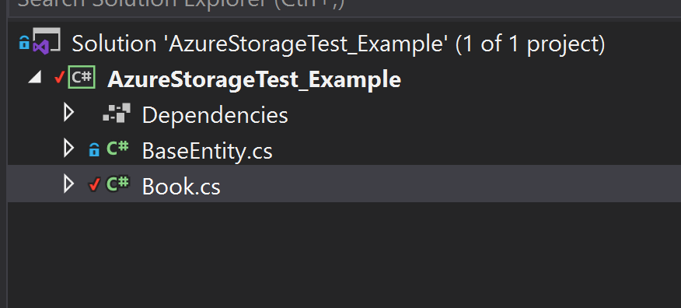
Book Entity Creation
We want to store book information in the Azure Cloud Storage Table, so we will create a “Book” class that will inherit our “BaseEntity” that we just created.
Please note that I have modified the code from the book example to automatically set the PartitionKey and RowKey when the Book is created. This is not necessary, but is a good way to ensure that the PartitionKey and RowKey are set properly when any new Book is created.
We want to have properties for the information that will be stored in the “Book Table”
BookName, Author, Publisher, and a BookId to ensure that the book is unique in the database.

Slide 36
Book Entity Creation
Note that we are using the BookId as the RowKey and the Publisher as the PartitionKey.
This will ensure that each of the Books will have a unique ID, but each partition in the Azure Cloud Storage will contain all of the books from a given publisher.
By doing this, we allow for uniqueness, but speed up searches when we want to get all the books by a specific publisher. This is a common example of thinking about how we will use the database information to determine what we want to use as the PartitionKey.
Remember, PartitionKeys should not be unique, but should be a group that is something we will use in our searches for the application.

Slide 37
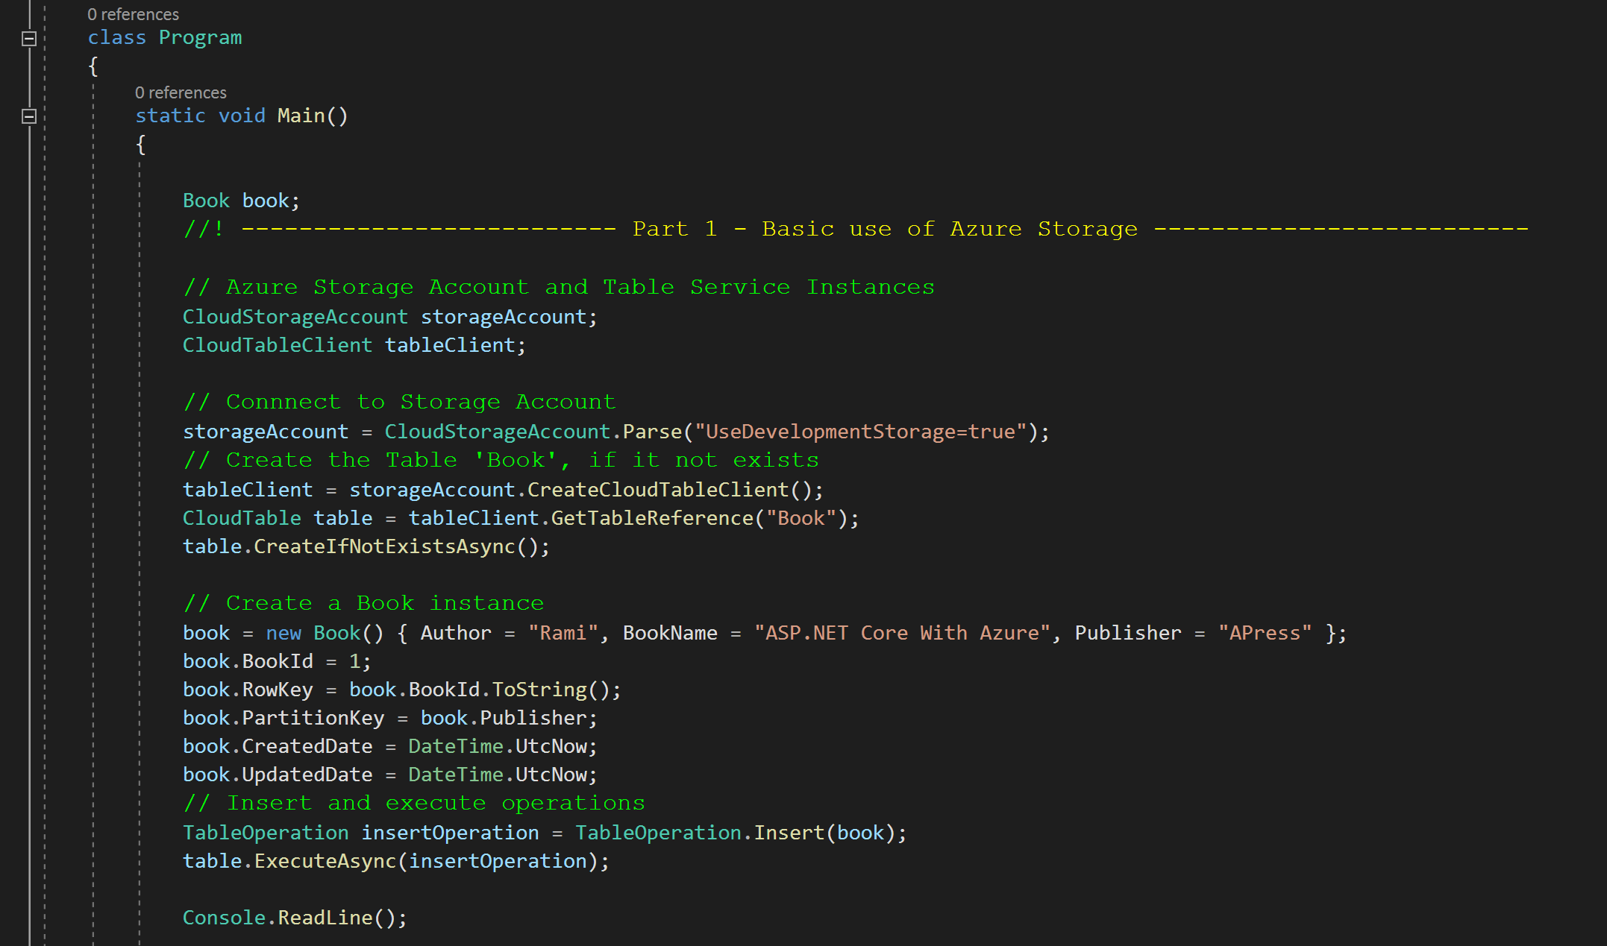
Updating the Program to Insert a Book into the Emulated Azure Cloud Storage
We will update the Program.cs Main method to create an Azure Storage Account that will be used with the Emulator so we can send and receive information from our database.
After that we create the “client” that will interact with the database directly by performing the “operation” that we want to achieve on the database tables.

Slide 38
Updating the Program to Insert a Book into the Emulated Azure Cloud Storage
Once we have the Account and Client, we will have to connect the account to the database (in this case the development database), and then get the “Book” table with the client. We also want to create the “Book” table if it does not already exist.
Once we have done this, we can create a Book with information, create the “insert” operation and then “execute” the operation with the client. With all of this coded, run the application with F5.

Slide 39
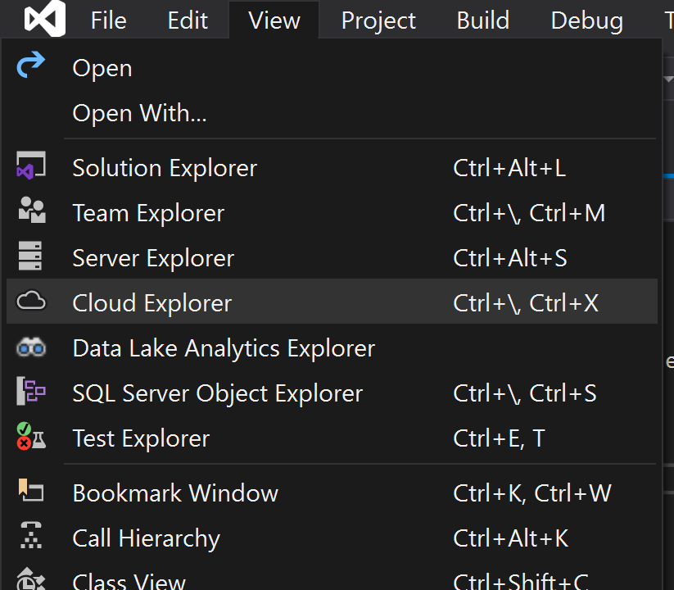
Checking the database to ensure it worked properly.
Now that we have performed the insert operation, let’s look at our “emulated” database.
Open the “Cloud Explorer” by finding it under the “View” menu at the top of the IDE window.

Slide 40
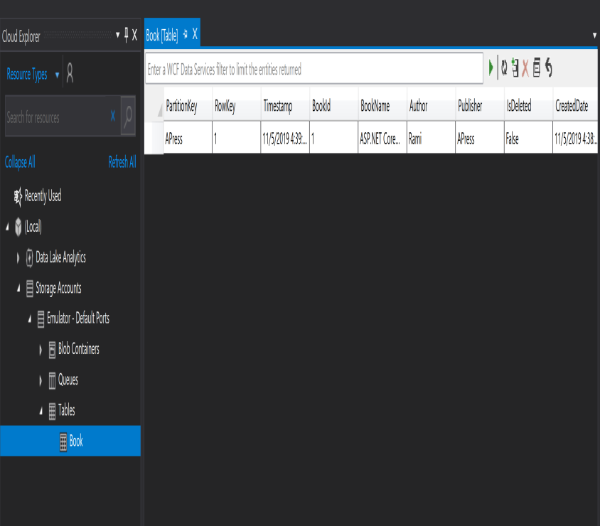
Checking the database to ensure it worked properly.
If everything is working correctly, you can find the “Book” Table, and double click on it.
This will “open” the table for viewing and we should be able to see the book that we just inserted into the “Book” table.

Slide 41
Next Lesson
In the next lesson we will discuss the “Unit of Work” design pattern.
This pattern was created to work with NoSQL database that do not have the ability to do multiple transactions at the same time. We have to manually control everything we do with the database to ensure consistency and accuracy. This is done with the UoW Design Pattern.

